Slide 1
Making Today’s Internet Faster
(Automatic Transition To Peer-to-Peer Download)
Notes:
Making P2P more adoptable.
More usable.
Useful in more situations.

Slide 2
Thanks!
Family
Teachers
wE\=f P'P= \ROVIDE A U966554F545DS6TFDV87654536:01 PM 4/5/20102 098YH6Ya 1W N.I
Notes:
This is your fault.

Slide 3
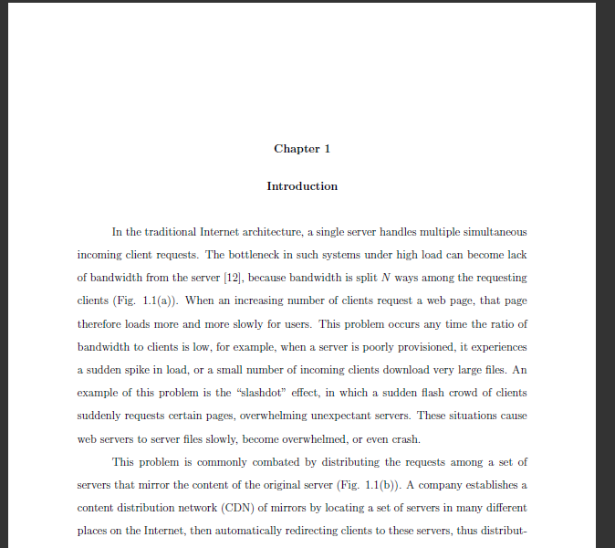
Thesis

Slide 4
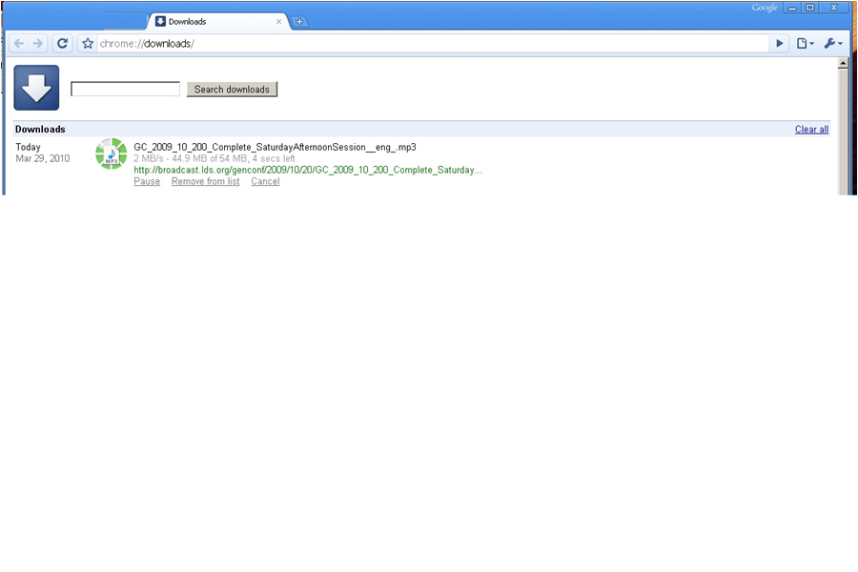
Fast download

Slide 5
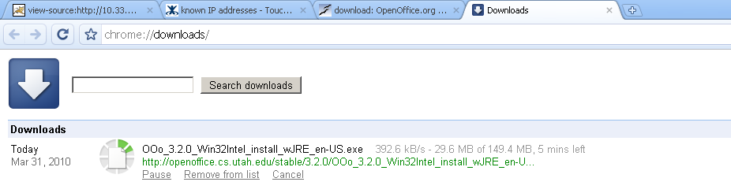
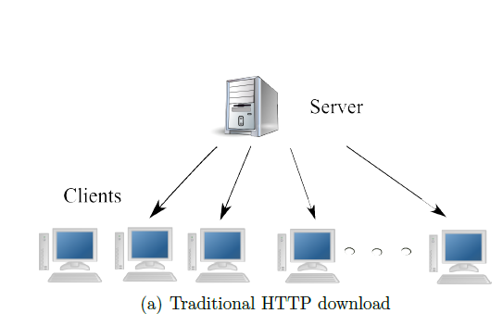
Slow downloads
Frustration
Wasted bandwidth
Under provisioned.
Too far.
Flash flood.
Notes:
Today's Internet can be slow at times.
Lodo:
Add a graph of network speed increasing so slowly compared to processors and disks (?) (?)

Slide 6
Your options
Hit reload.
Wait.
Try somewhere else.
Download Manager.
Add a local caching proxy.
Add local bandwidth.
Beg the server to change how they serve the file.
Notes:
“Go and do something else”
“Go and watch something on youtube”
“Feel frustrated”

Slide 7

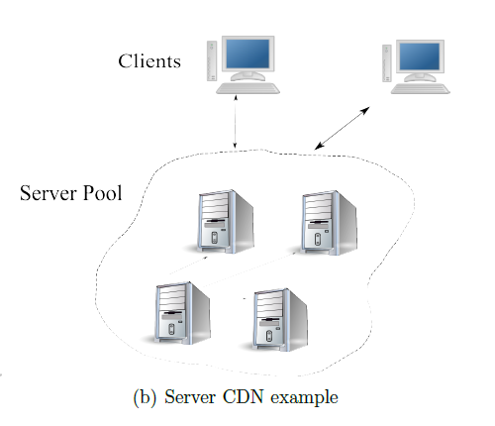
Server options
Buy more bandwidth.
Move.
Buy more servers/rent a CDN
Popular
Turn to P2P

Slide 8

CDN can fail
Notes:
Can become overloaded.
You need to employ an expensive CDN.

Slide 9

Turn to P2P
BitTorrent
Create + host BitTorrent File.
Create tracker.
Peers download and share blocks (efficient).
Works well for large popular files.
“When I created BitTorrent in 2001, my mission was to solve the problem every website has when distributing large, popular files” – Bram Cohen
Notes:
“Melissa style” explanation (you download half, your friend downloads half, you share halfs).
You don’t need any extra servers, peers do most of the extra hosting.

Slide 10
BitTorrent fails
Server side.
Per File
Have to provide traditional anyway.
Lack of clients.
Stigma.
Extra maintenance.
Large Files.
Unknown demand.

Slide 11
BitTorrent fails
Clients
Extra setup/time per file.
Small files
Techno intelligencia
Non integrated.
Manual.
Not HTTP optimized.
It should be ignored speed-wise
Duplicate
Costs time
Not available.
Notes:
It would be annoying for small files because it is so manual.
2) When a user runs into this, it typically takes extra time in order to download this way, because you have to go through some extra steps, like downloading the .torrent file, then waiting some time for your client to contact the tracker, get peer lists, find peers that are willing to share with you, etc.
It would be painful to have to do this for many small files, like browsing a web page. Up to 10 files for byu's web site. Even if they *did* a BitTorrent file for each of these small files, today’s systems include a manual step in order to download each file. Modern browsers don’t handle inline p2p. So P2P basically can’t be used for a typical web page.
How many sites actually offer you that stuff?
Normal people do not use BitTorrent. Not useful to them.

Slide 12
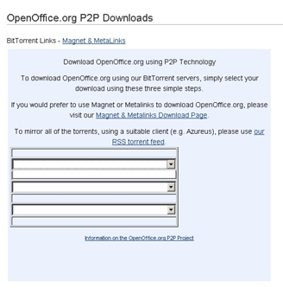
BitTorrent can Fail
Not enough seeds.
Closed ports.
Tracker
Extra files.
Users don’t have client installed (chicken/egg).
Clients aren’t configured to use HTTP well.
Notes:
Hard to configure—hard to get to work right except for very popular files.

Slide 13
Automatic Swarming
Make swarming more usable/adoptable.
Notes:
Designed to keep the, scalability and cost effectiveness of BitTorrent, while making it useful in more situations than BitTorrent currently is.
Alleviate these problems.

Slide 14
Automatic Swarming -- Goals
Work for any file on any server.
Easy for clients.
No extra dedicated hardware.
Work for small files.
Non intrusive.
Notes:
All areas where BT falls short.
Also: only go to P2P when necessary (try to be as fast as normal download).
Non intrusive: has a timeout, only serves out files that you download so you never get tainted by questionable content.

Slide 15
Automatic Swarming
Basic Algorithm:
Monitor download
Automatically switch to a Peer-to-Peer download if it becomes slow.

Slide 16
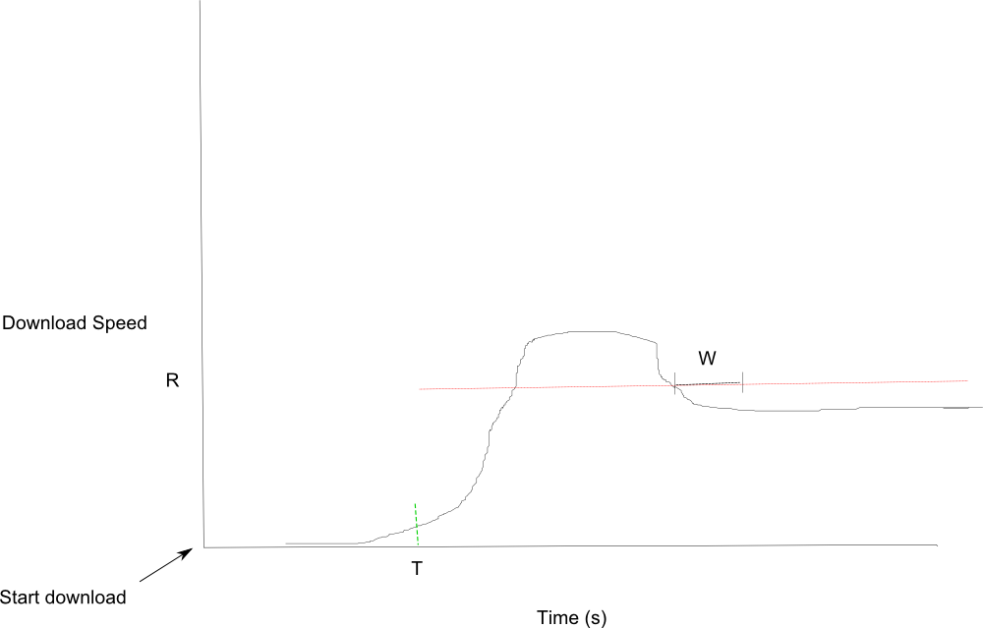
Monitor Download

Slide 17
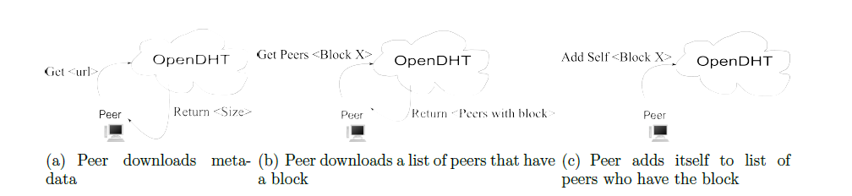
P2P: Transition
Notes:
Note the

Slide 18
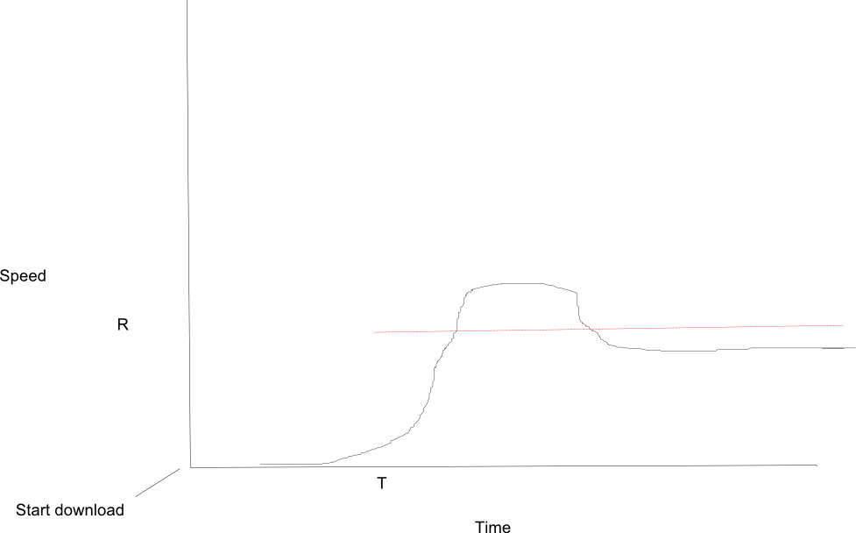
Details
T starts immediately.
R is calculated W seconds after T
Private OpenDHT instance.
Redundant DHT keys/gateways.
Polls on lack of peers (1s)
Downloads block from origin
Per block lists.
Last block problem
Notes:
Add descr. picture here?

Slide 19
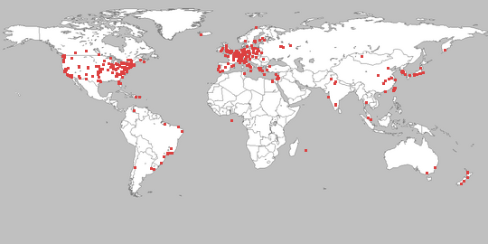

Methodology.
PlanetLab
Private OpenDHT
Run until finish.
Repeat 3x.
Graph percentiles: download times, DHT response times, causes for transitioning to P2P.
BYU server
256 KB/s

Slide 20
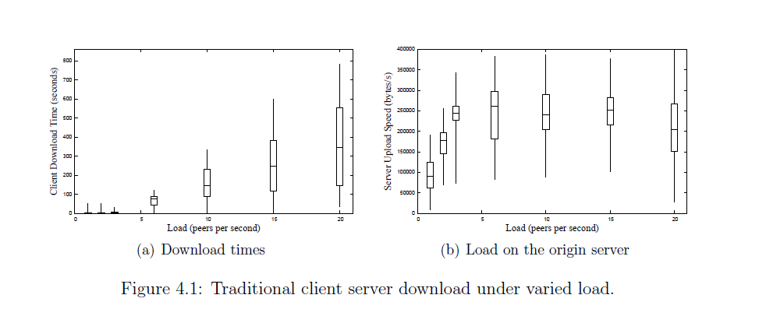
Performance Client-Server
File size: 100 KB, R 128 KB/s, W 2s, T 1s, Linger 60s. Increasing number of startup peers.
Notes:
Note that a semi-popular website might serve half a
million hits a day, which averages to 6 per second, so our limit of 20 per second is similar, if
you take into consideration spikes in load.

Slide 21
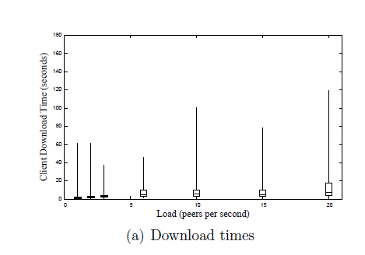
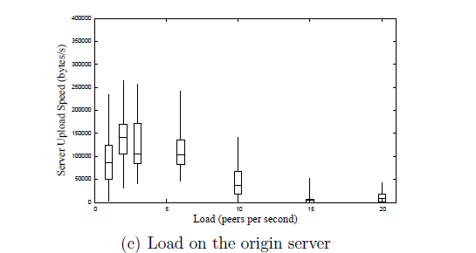
Performance – Automatic Swarming
Notes:
At a load of 20 peers/second, 99.5% of peers give up on
the origin server because of a slow first byte after one second (T). They then query the DHT
for a peer list, and receive a response with a median latency of 5.2 seconds.

Slide 22
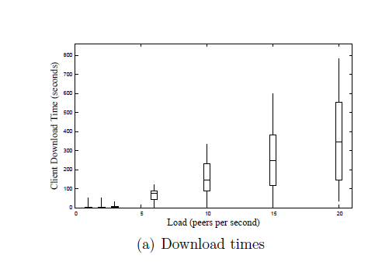
Comparison
Notes:
TODO real graph here.

Slide 23
Effect of Varying Parameters
T, R, W
Multiple Files
Large Files
Block Size
Linger Time
Peer count
1000 peers at 15/second (66 seconds).
100 KB file, 100 KB block size, conn. Limit 5, R 128 KB/s, T 1s, W 2s, Linger 20 s.

Slide 24
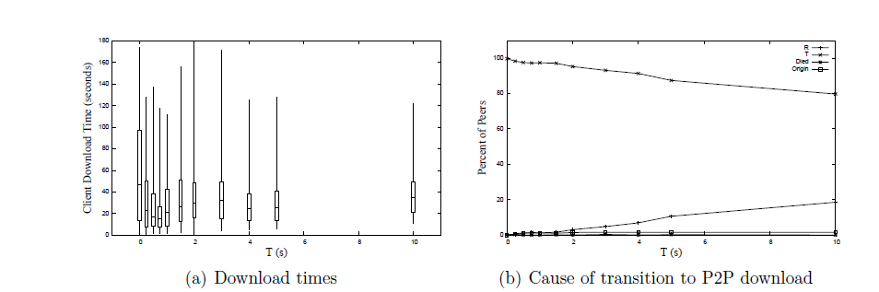
Varying T

Slide 25
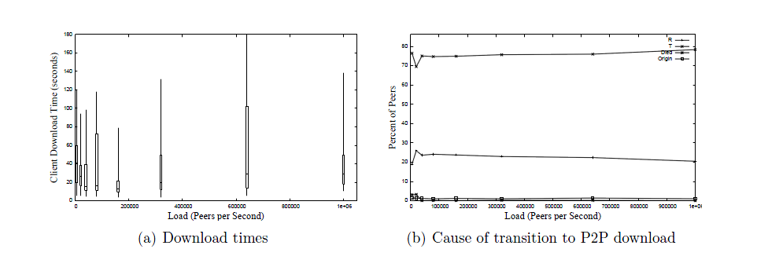
Varying R
Notes:
Please redo one graph here. Please?
TODO that is not peers per second and it lops off the one graph.
This shows you that “once you have one that’s high enough, you’re good to go”

Slide 26
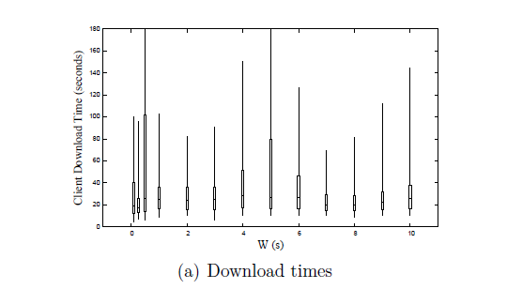
Varying W
Notes:
Similar change to R. Because it only affected at most the first few, because after that the server became saturated and T would always fire first.
Median download times are 17 seconds with W set to 0.25 seconds. For W > 0.25 seconds median download
times stay at approximately 25 seconds.
Probably want that “other” graph in here, too, then, to show “oh it’s all T”? TODO

Slide 27
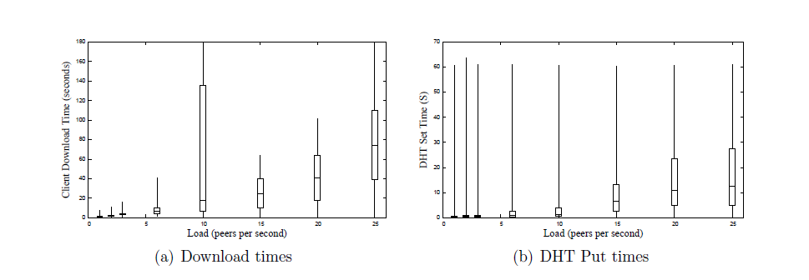
Full web Page
100 KB file, 10 15K files.
Notes:
.
Note that our linger time was 20 seconds, so the DHT was becoming less effective under higher load.
This is essentially like 10 times as much load as we were putting on the system before.

Slide 28
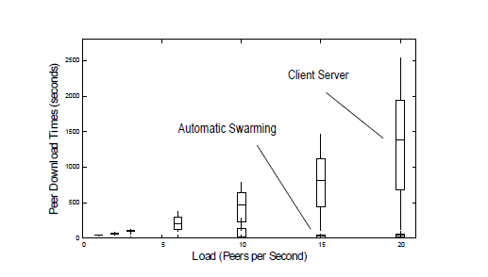
Versus Client-Server

Slide 29
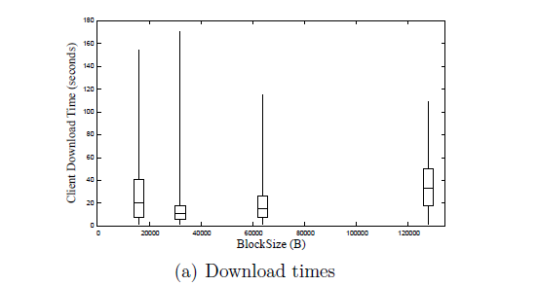
Block Size
Notes:
Fastest was 32 KB, presumably because I download from the last few peers in parallel, so this fits best.

Slide 30
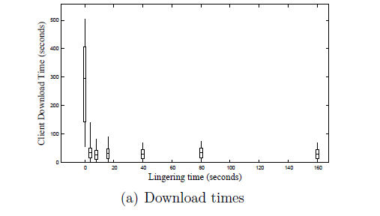
Linger Time

Slide 31
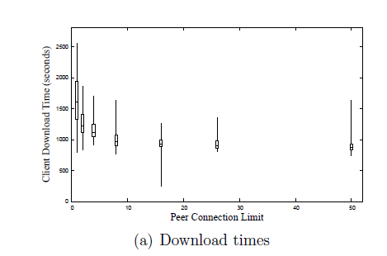
Peer connection

Slide 32
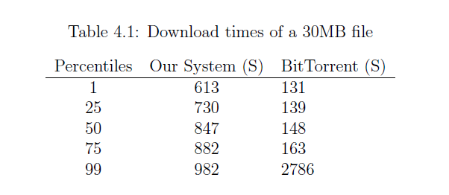
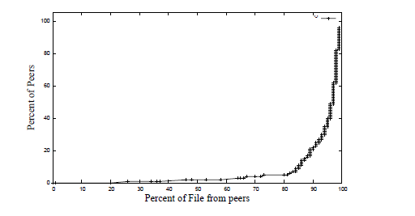
With Large Files
Notes:
“Ours doesn’t perform as well as BT for large files.”
You can see that at about 730 to 882 seconds most of our peers finish the file, and most of the peers download it from peers, so once we get the file out there we work all right, but we could do some work still to increase our speed of propagating the blocks.”
We're not entirely sure why BitTorrent is faster.
One factor aecting performance is that BitTorrent's seed limits outgoing connections to
7, whereas Apache's connection limit is 256. This may allow BitTorrent to propagate full
blocks more quickly to peers. BitTorrent's seed also favors peers with higher download
speeds, which may help propagate blocks. In this test, it uses a dedicated tracker, which
makes peer rendezvous quicker than using a DHT. BitTorrent uses a \rarest block rst"
selection policy, enabling it to choose blocks more eciently.

Slide 33
BitTorrent Large File optimizations
Seeds limit outgoing connections.
Favor stronger connections.
Dedicated tracker.
Rarest Block First.
Notes:
We're not entirely sure why BitTorrent is faster.
One factor aecting performance is that BitTorrent's seed limits outgoing connections to
7, whereas Apache's connection limit is 256. This may allow BitTorrent to propagate full
blocks more quickly to peers. BitTorrent's seed also favors peers with higher download
speeds, which may help propagate blocks. In this test, it uses a dedicated tracker, which
makes peer rendezvous quicker than using a DHT. BitTorrent uses a \rarest block rst"
selection policy, enabling it to choose blocks more eciently.

Slide 34
Conclusion
Best settings.
T: 0.75 s
R: 160 KB/s
32 KB blocks
Peer limit: 16
Linger: 16 s
Viable.
30 x as fast for small files
Backs off server.
Notes:
"real" use is probably currently [who knows for sure] "most useful in the wild" for larger static files, still.
Or somebody serving from a limited connection.
Kind of an auto-BitTorrent for all files on the Internet, though we have shown it can work well for small files, too, so something like this could become a real contribution to browsing the Internet.
Which is good. We have made P2P more useful, researched a bit into how to make it more adoptable, more useful in more spheres.
Demo?

Slide 35
BitTorrent fails
Server side.
Per File
Have to provide traditional anyway.
Lack of clients.
Stigma.
Extra maintenance.
Large Files.
Unknown demand.

Slide 36
BitTorrent fails
Clients
Extra setup/time per file.
Small files
Techno intelligencia
Non integrated.
Manual.
Not HTTP optimized.
It should be ignored speed-wise
Duplicate
Costs time
Not available.
Notes:
It would be annoying for small files because it is so manual.
2) When a user runs into this, it typically takes extra time in order to download this way, because you have to go through some extra steps, like downloading the .torrent file, then waiting some time for your client to contact the tracker, get peer lists, find peers that are willing to share with you, etc.
It would be painful to have to do this for many small files, like browsing a web page. Up to 10 files for byu's web site. Even if they *did* a BitTorrent file for each of these small files, today’s systems include a manual step in order to download each file. Modern browsers don’t handle inline p2p. So P2P basically can’t be used for a typical web page.
How many sites actually offer you that stuff?
Normal people do not use BitTorrent. Not useful to them.

Slide 37
BitTorrent can Fail
Not enough seeds.
Closed ports.
Tracker
Extra files.
Users don’t have client installed (chicken/egg).
Clients aren’t configured to use HTTP.
Notes:
Hard to configure—hard to get to work right except for very popular files.

Slide 38
Automatic Swarming -- Goals
Work for any file on any server.
Easy for clients.
No extra dedicated hardware.
Work for small files.
Non intrusive.
Notes:
All areas where BT falls short.
Also: only go to P2P when necessary (try to be as fast as normal download).

Slide 39
Automatic Swarming
Make swarming more usable/adoptable.
Notes:
We’ve made a step in that direction. It has potential.

Slide 40
Future Work
Back off the origin.
Validate Integrity.
Differentiate better for static/non-static.
Better use of the DHT (fairness, speed).
Dynamic parameters.
Incentives.
Privacy.
Mirrors.

Slide 41
Questions
?

